Slide 1
Operating modes of 8086
How to decide operating mode of 8086 ?????
MN/MX pin of 8086
Minimum mode
Maximum mode
When there is only one processor it is called as minimum mode.
When there is more than one processor it is called as maximum mode.
MN/MX = 1
MN/MX = 0

Slide 2
Minimum mode of 8086

Slide 3
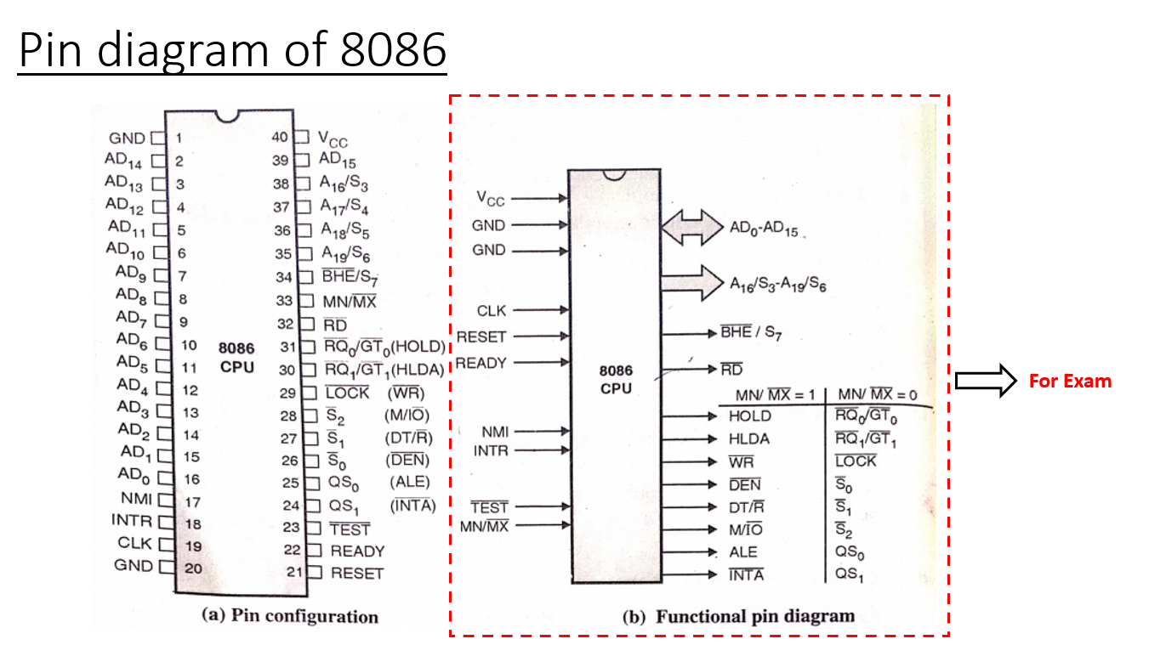
1

Slide 4
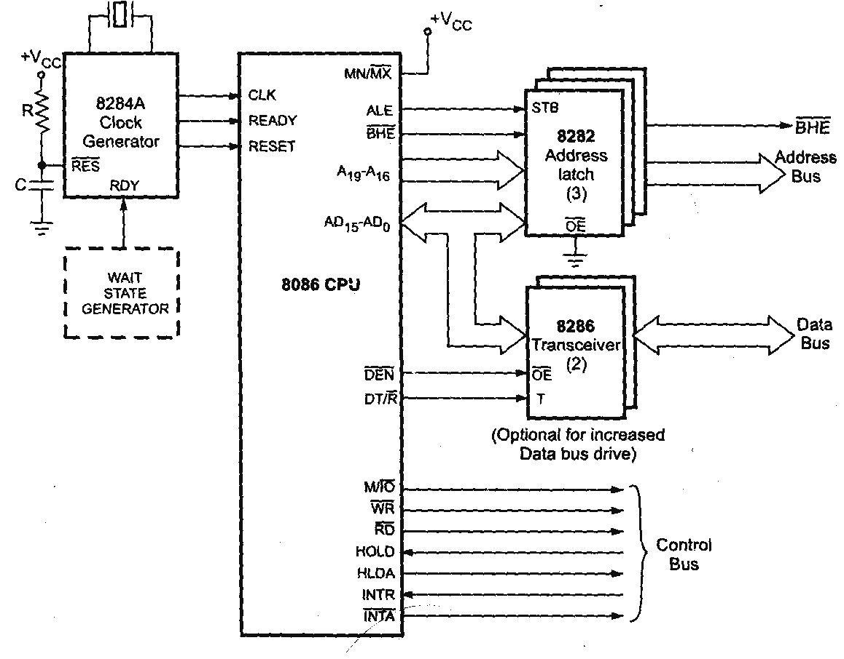
Minimum mode of 8086

Slide 5
S3-S7 are status signals given by processor
A19 – A0
S3 | S4 | Seg
0 | 0 | ES
0 | 1 | SS
1 | 0 | CS
1 | 1 | DS
To enable higher bank(odd)
BHE
A19 – A16
A15 – A0
To enable lower bank(even)
S7
S6 - S3
D15 – D0
S3 and S4 signals use to tell right now the operation that happening, is happening on which segment
BHE /S7
A19/S6 – A16/S3
AD15 – AD0
S5 : 0= IF=0
1= IF =1
1
4
16
S6 : 8086=Bus Master(the one who controls the bus)
Other=1
21 pins are multiplexed pins
S7 : Reserved

Slide 6
How to perform multiplexing?????
A19 – A0
ALE
ALE (Address Latch Enable)
BHE
A19 – A16
A15 – A0
1
S7
S6 - S3
D15 – D0
0
This is multiplexed bus so either data or address
BHE /S7
A19/S6 – A16/S3
AD15 – AD0
1
4
16
To reduce no.of pins multiplexing is used.
To differentiate between data and address Demultiplexing is used.

Slide 7
Demultiplexed Address and Data
Bus dose not store value it is use for transfer the data or address
To store the value we required separate chips : 1. 8282 latch
2. 8286 transceiver
Latch --- Address & Transceiver-- data
Address bus is used to access the memory locations and data bus is used to access the data of that memory location, both are the different.
Hence demultiplexing is used.
8086
1
(3)
Latch is used to store the address
It has flip flops inside to store address
It consist 2 signals OE i.e. output enable and STB strobe
OE bar is grounded means it is always active low.
Important signal is STB i.e Strobe.
/ 0
8282- 8 bit latch
BHE
ALE
STB
/ D
AD15 – AD0
A
A19/S6 – A16/S3
BHE /S7
21
A19 – A16
There are total 21 multiplexed lines which are used to send address/data
OE
8286- 8 bit Transceiver
(2)
Latch
30
25
25
25
DT/R
T
D15 – D0
DEN
OE
Bus

Slide 8
Demultiplexing of an Address Bus
When strobe is 0 whatever contents pass on address bus is not allowed to enter into latch.
It will display the previous(old) value.
ALE is connected with STB which is used to enables the latching of address.
When strobe is 1 whatever contents pass on bus is allowed to enter into latch and gives output
ALE=1=STB, bus is carrying address which is latched by 8282 latch.
ALE=0=STB, bus is carrying data, hence it is not latched by latch.
1
0
8086
1
/
0
(3)
For 8086 addressing (3) 8282 latches are required because address of 8086 is 20 bits
And single latch size is 8 bit.
8282- 8 bit latch
ALE
STB
BHE
AD15 – AD0
A
/
D
36H
A19/S6 – A16/S3
06H
A19 – A16
36H
36H
06H
BHE /S7
36H
It is always enabled because OE is active low and grounded
OE
36H
06H
8286- 8 bit Transceiver
(2)
D15 – D0
DT/R
T
IT is enabled or disabled because data coming on bus is not always data if ALE 0 it means it is address
DEN
OE
1 / 0

Slide 9
Demultiplexing of Data Bus
Hence for getting pure data bus we required one more chip which is called as 8286 – transceiver (transmit and receive)
When enable then only output appears on output line
Is in this a pure data bus???
It is 8-bit tri-state buffer which is used to transmit and receive the data.
NO
0
0
???
Tri-state Buffer
When ALE=1, bus is carries Address, that addr will go into the latch
I/P
O/P
It has 2 signals: T and OE bar
1
1
*** When ALE = 0 and addr will pass through bus transceiver should disabled
That addrs will also go down
8086
1
/
0
(3)
Only when the bus carries data transceiver should enabled and it will pass data.
8282- 8 bit latch
ALE
STB
BHE
AD15 – AD0
A
/
D
A19 – A16
A19/S6 – A16/S3
A
OE is connected with DEN signal of 8086.
DEN (data enable) is sends 0 when bus carries data
BHE /S7
It is always enabled because OE is active low and grounded
OE
A
Transmitter or Receiver?????
8286-enabled
T (Transmitter) is connected with DT/R signal of 8086.
DT/R = 0 , 8286 transmit data.
DT/R = 1, 8286 Receive data
8286- 8 bit Transceiver
D
(2)
Bi-directional
A
D15 – D0
/
OE bar is enabled or disabled because data coming on bus is not always data if ALE 0 it means it is address
For 8086 data (2) 8286 transceivers are required because data of 8086 is 16
Bits.
1
0
DT/R
T
DEN
OE
1
/
0

Slide 10
Which signal changes first?????
8282 enable and latches the address
ALE- STB
1
0
8282 disable and data will not enter
DEN - OE
1
0
8286 enable and store the data
8286 disable so address will not enter
8086
(3)
1
0
8282- 8 bit latch
ALE = 1, bus will become address bus
ALE
STB
BHE
DEN= 1, bcz bus carries address
AD15 – AD0
A19 – A16
A
D
D
A19/S6 – A16/S3
If DEN bar changes first i.e become 0 to 1 the whole logic become wrong because bus still carries address.
BHE /S7
If bus changes then Data will also transferred into address
OE
Sequence :
1. ALE = 1 & DEN bar=1, bus will become address bus
and address latched.
8286- 8 bit Transceiver
(2)
2. ALE = 0 but still bus carries address, hence DEN bar=1
D15 – D0
3. now change the mode of bus from A to D
DT/R
T
4. make DEN bar = 0 to get the data
DEN
1
0
0
OE

Slide 11
8086
There are four operations :
Memory read
Memory write
I/O read
I/O write
 | M/IO | RD | WR
IOR | 0 | 0 | 1
IOW | 0 | 1 | 0
MEMR | 1 | 0 | 1
MEMW | 1 | 1 | 0
Read from memory
Write into memory
Read from I/O
Write into I/O
Memory
I/O
8086
IOR
M/IO
3:8 decoder
IOW
RD
MEMR
WR
MEMW
Memory
I/O

Slide 12
VCC
8086
G1
74138
3:8
decoder
M/IO
Y0
C
Y1
IOR
Y2
IOW
RD
B
Y3
Y4
Y5
MEMR
WR
A
Y6
MEMW
Y7
G2A
G2B
 | M/IO | RD | WR
IOR | 0 | 0 | 1
IOW | 0 | 1 | 0
MEMR | 1 | 0 | 1
MEMW | 1 | 1 | 0

Slide 13
18 MHz
To produce 6 MHz at 33% duty cycle so
18 MHz divided by 3.
Duty Cycle :
It is the ratio of ON time and total time
A clock pulse is on for some time and off for some time.
It can be active high or active low.
At what time of point dose the transition take place is called as duty cycle.
If transition is at mid point it is called 50% duty cycle
3 X
6 MHz
RES
X1
X2
CLOCK
8086
8284 clock generator
RESET
READY
RDY
RESET
READY
50%
6 MHz
20%
70%
90%
Each clock pulse is used to triggered processor to perform activities.
In above example all of have different duty cycle but same clock frequency

Slide 14
Interrupt
NMI : It is hardware interrupt. Vector for NMI is 0002. processor will
execute ISR from this location
INTR : It is interrupt request by device to the processor
INTA : In response to INTR signal processor will generate 2 INTA
pulse During these pulse device will calculate vectored
address and pass to the processor and according to
calculated vector processor will executes ISR
18 MHz
To produce 6 MHz at 33% duty cycle so
18 MHz divided by 3.
3 X
6 MHz
RES
X1
X2
CLOCK
8086
8284 clock generator
RESET
READY
RDY
(Bus request) DMA
Direct memory access is used to control the system bus
If DMAC wants to control the system bus then it will send HOLD signal to processor
In response to HOLD signal processor will release the system bus control and generate HLDA signal to handover the control of bus system to DMAC
RESET
READY
NMI
Interrupt
6 MHz
INTR
INTA
Processor
Memory
HOLD
(Bus request) DMA
HLDA
Can not directly transfer data bet memory and I/O for ths required concept DMA
DMA
I/O

Slide 15
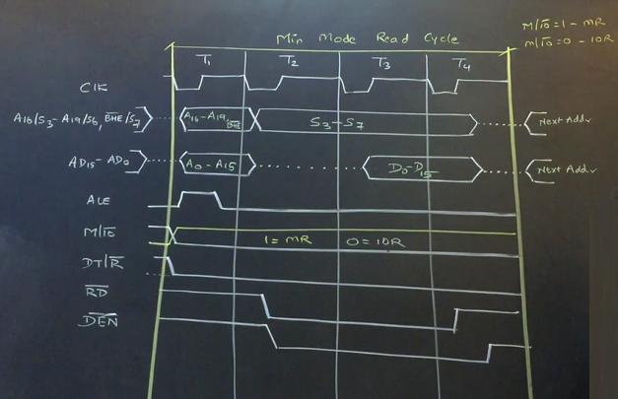

Slide 16
Maximum mode of 8086

Slide 17
0

Slide 18
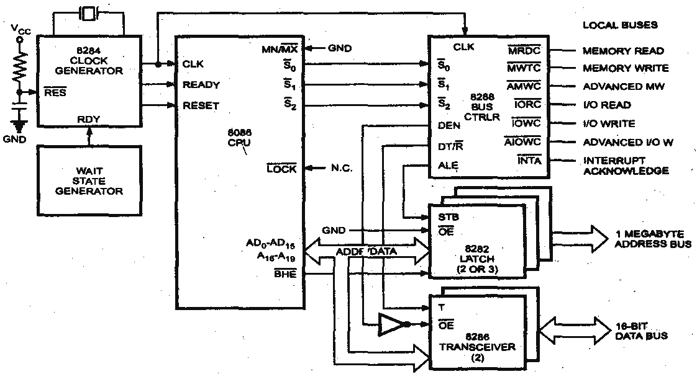

Slide 19
I/O Co-Processor
In maximum mode there are multiple processors. We can connect 8087 and 8089 co-processors with 8086.
used to perform I/O operations.
8089
To perform multiprocessing maximum mode is used.
8086
RD
Disabled in MAX mode
Process simultaneously
MN | MX
HOLD | RQ0/GT0
HLDA | RQ1/GT1
WR | LOCK
DEN | S0
DT/R | S1
M/IO | S2
ALE | QS0
INTA | QS1
MN/MX
(0)
8087
used to perform very complex arithmetic operations.
Math Co-Processor

Slide 20
Disabled in MAX mode
RQ – GT Request and Grant :
The term multiprocessing means more than one processors are working simultaneously.
Even though there are three processors but there is always only one system bus.
Other processors like 8087 and 8089 are requesting 8086 for control of system bus.
The one who control the system bus is called as bus master and by default 8086 is bus master.
If any one processor wants to become bus master or wants to access system bus it will request to 8086 through RQ bar pin.
Then 8086 will release the system bus and grant the permission through GT bar pin.
8086
RD
MN | MX
HOLD | RQ0/GT0
HLDA | RQ1/GT1
WR | LOCK
DEN | S0
DT/R | S1
M/IO | S2
ALE | QS0
INTA | QS1
If 8087 wants to become bus master it will send request to 8086 using RQ bar.
After receiving RQ bar signal 8086 releases the system bus and grant the permission by sending GT bar signal.
Now 8087 is bus master, it will perform its task and after finishing its work it will send release signal to 8086.
MN/MX
8086
(0)
This three signals combined in single line.
There two co-processor, hence there are two request and grant signals ie. RQ0-GT0 and RQ1-GT1
GT
0
RQ
This are the active low signal which means when there is nothing then status of signal is 1.
1
GT
release
1
1
When request occurred it will become 0 and immediately gose high 1.
RQ
release
0
RQ0 – GT0
Highest Priority
8087
Processor will send 0.
RQ1 – GT1
Lowest Priority

Slide 21
LOCK
Instruction Cycle is the total time required to fetch, decode and execute the instruction.
Instruction Cycle
M1
M2
M3
M4
Machine cycle is memory read/write
T1 T2 T3 T4
T1 T2 T3 T4
T1 T2 T3 T4
T1 T2 T3 T4
T- states required to complete one machine cycle
While processor doing it’s task there two events that can disturb the processor.
1. Interrupt Request
2. Bus Request
Interrupt Request
When interrupt request occurs processor will execute its current instruction and the it will give service.
Bus Request
When interrupt occurs processor has to execute ISR there fore it will first execute current instruction
Service
Service
When bus request occurs, then processor executes its current machine cycle and then provide service.
When bus request occurs there is no ISR execution hence processor executes current m/c cycle
processor pause the execution and transfer the bus control but processor can not pause in between T states.

Slide 22
LOCK
Instruction Cycle is the total time required to fetch, decode and execute the instruction.
Instruction Cycle
M1
M2
M3
M4
Machine cycle is memory read/write
T1 T2 T3 T4
T1 T2 T3 T4
T1 T2 T3 T4
T1 T2 T3 T4
T- states required to complete one machine cycle
Bus Request
(LOCK)
We have write following instruction CX, [2000H]
LOCK=0
By executing this instruction CX gets content of given memory location.
Interrupt Request
Service
During this instruction as a programmer we don’t want processor to be disturb.
Bus Request
Service
LOCK
CX , [2000H]
Who can disturb the processor?
Service
Interrupt Request
Bus Request
Because of LOCK prefix processor execute current instruction and not release the bus control and also inform to all device that bus control is not released by making LOCK = 0
Hence assign LOCK prefix before the instruction which we don’t want to be disturb by bus request.

Slide 23
Control signals are generated by the bus master.
S0
S1
S2
Status signal :
When 8086 is bus master, 8086 is responsible to generate control signals i.e. memory read, memory write
8086
At the same time 8087 can not produce any control signal to access RAM because 8086 is bus master and vice-versa
RD
Hence there is one solution to connect all devices with all processors which is not feasible because it will increases the connectivity and circuitry.
WR
8087
RD
***In MAX mode no processor is allow to generate control signals***
Who will generate??????
WR
8288 IC is responsible to generate all the control signals
RAM
S0
S1
S2
8086
When a processor who is bus master wants to generate control signal through 8288, then the processor has to inform 8288 using status signals.
8288
8087
S0
S1
S2

Slide 24
Who ever is the bus master using status signal will inform 8288 what operation it wants to perform.
S0 | S1 | S2 | Control Signal
0 | 0 | 0 | INTA
0 | 0 | 1 | IO Read
0 | 1 | 0 | IO Write
0 | 1 | 1 | Halt
1 | 0 | 0 | Instruction Fetch
1 | 0 | 1 | Memory Read
1 | 1 | 0 | Memory Write
1 | 1 | 1 | Idle
8288 will decode the status and produce control signals.
8288 will produce control signals using given table.
Example
1. 8086 wants to produce memory read control signal, then it will generate 1 0 1 status signal and send it to 8288
2. 8288 will decode this status signal and produces memory read control signal
Both processor can not send same status signal at the same time
S0
S1
because only bus master can generate control signals.
By default 8086 is default bus master so 8086 can send status signal.
S2
8086
1 0 1
When 8087 wants to send status signal first it has to send bus request to 8086 if permission granted then 8087 will become bus master and produces control signals.
8288
8087
Memory Read
S0
S1
S2

Slide 25
8284 clock generator is responsible to produce clock signals. These synchronised signals are applied to 8086 and other connected devices.
There are 21 multiplexed lines.
When ALE = 1 , they carry address & ALE =0, data.
These 21 lines are given to 2 – devices, 8282 and 8286.
8282 latch will select address & 8286 buffer will select data.
8288 will produce control signals.
In maximum mode all buses (address , data, control) control by 8288.
In maximum mode 8288 is responsible to generate ALE signal instead of any processor.
RQ0/GT0
RQ1/GT1
NMI
Only for 8087
INTR
TEST
QS0
QS1
8288 required two information :
Machine cycle is active for 4T states
When to make ALE =1
Start of new m/c cycle
ALE is high for only 1st T-state.
When to make ALE =0
Which T-state is going on
Control signal informs about new operation so ALE will be high
Clock signal informs about T-state .

